Slide 1
Hyperbilirubinemia
Thomas Mike, MD
8/29/22
Resident Noon Conference

Slide 2
Objectives
By the end of this session, learns will be able to:
1) Define hyperbilirubinemia, jaundice, acute bilirubin encephalopathy, and kernicterus
2) Explain a few of the reasons neonates get hyperbilirubinemia
3) Describe the evaluation/management of neonatal hyperbilirubinemia based on the most current guidelines

Slide 3

Background
Bilirubin
  Breakdown product of RBCs
  All babies have increased indirect bili to some degree
  If it gets too high, unbound bilirubin can affect the baby
    Jaundice, scleral icterus
    Acute Bilirubin Encephalopathy
    Bilirubin-induced neurologic dysfunction
  Bilirubin typically peaks around day 3-4

Slide 4
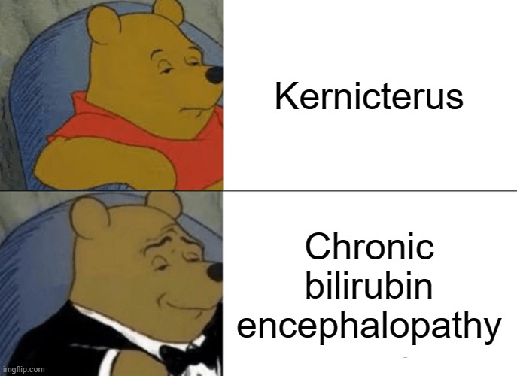
Background
Bilirubin
  Breakdown product of RBCs
  All babies have increased indirect bili to some degree
  If it gets too high, unbound bilirubin can affect the baby
    Jaundice, scleral icterus
    Acute Bilirubin Encephalopathy
    Bilirubin-induced neurologic dysfunction
  Bilirubin typically peaks around day 3-4

Slide 5
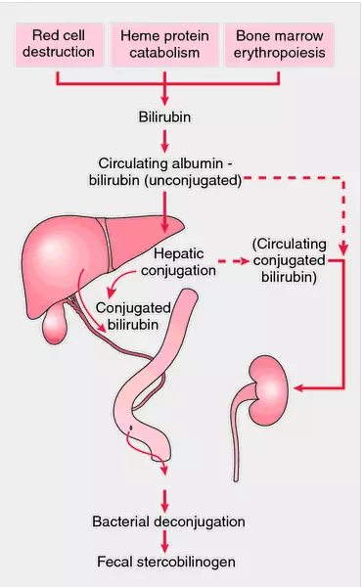
Normal Metabolism
Binds to albumin and goes to liver
In liver, becomes conjugated into direct bili
Direct bili gets excreted into intestines via bile
Bile gets excreted via stool OR reabsorbed

Slide 6
What goes wrong
Too much hemolysis
  ABO and/or Rh incompatibility
Not enough albumin
Problems with conjugation
Can’t excrete conjugated bilirubin
Can’t stool enough
Too much reabsorption

Slide 7
What about non-newborns?
Scleral icterus and jaundice can happen outside of newborn purposes
  Usually pathologic
  Consider excess hemolysis, liver dysfunction (crigler-Najjaar, Gilbert's, hepatitis),biliary obstruction, etc

Slide 8
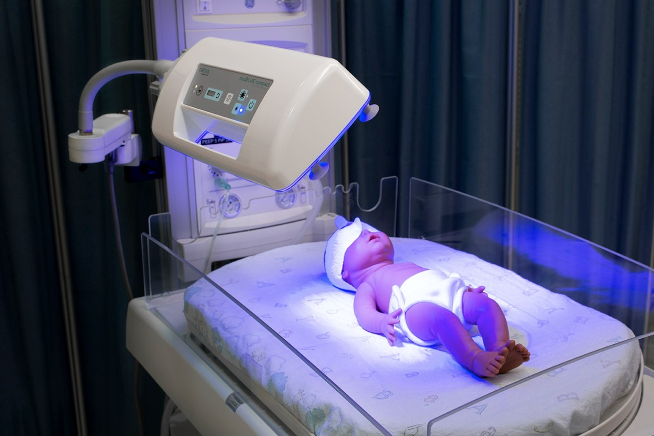
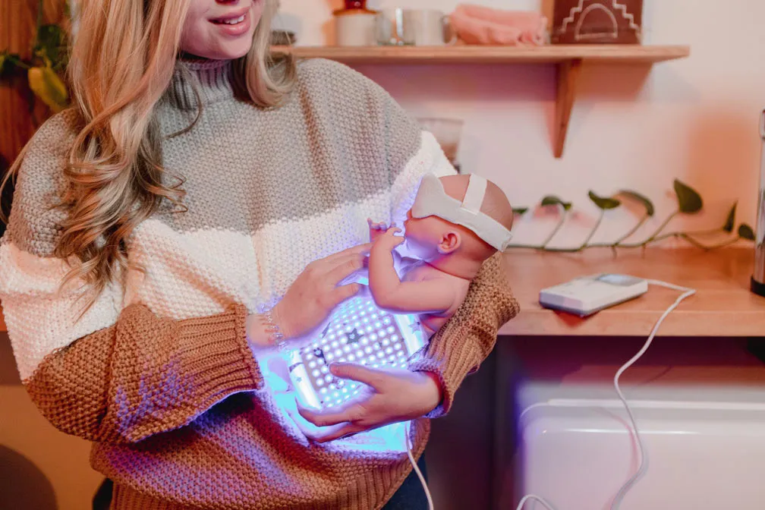
Treatments
Supportive Care (home)
  Feed the baby
Phototherapy (hospital, sometimes home)
  Intensive phototherapy: 475nm wavelength
  Not entirely without risks
    Cost, possible increased risk of epilepsy
Exchange Transfusion (NICU)
IVIG (NICU)
https://www.sciencerepository.org/phototherapy-and-its-applications
https://motifmedical.com/bilitouch-phototherapy-blanket

Slide 9
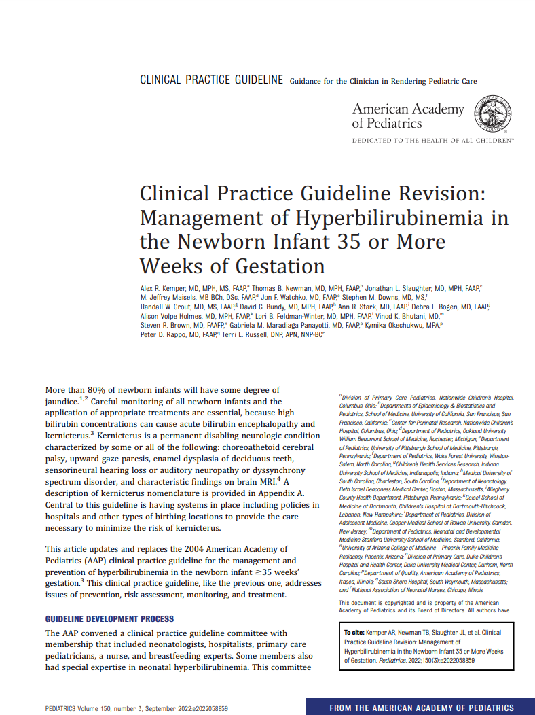
The New Guidelines
Released 8/2/2022
Biggest changes from 2004 guidelines
  Higher phototherapy levels!
  Clear guidelines on recommended follow-up!
  No more "low-intermediate risk, high-intermediate risk, etc" nonsense!
  Clear guidelines on escalation of care!

Slide 10
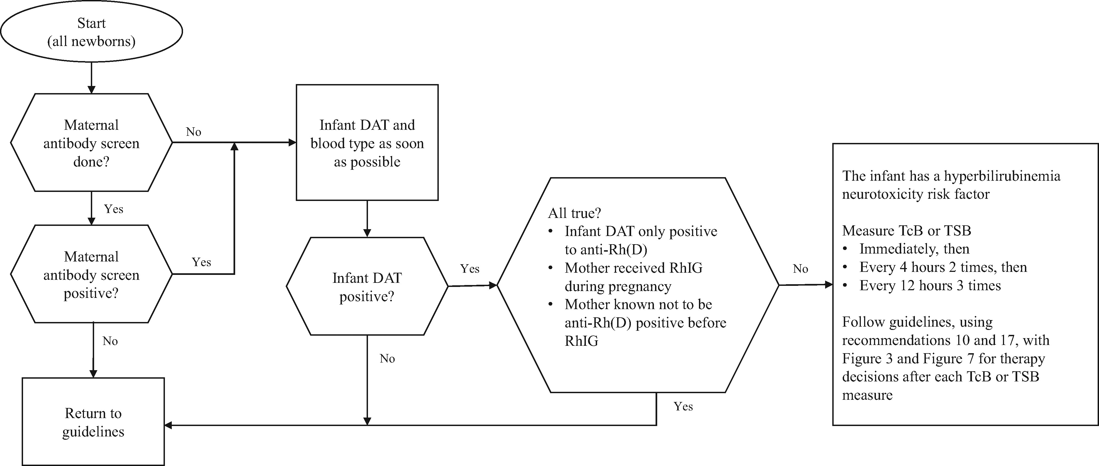
The New Guidelines
Prevention
Prevention of Isoimmune disease
- All expectant mothers should have prenatal antibody screening done. If not done, check blood type and direct antiglobulin test (DAT) in baby ASAP

Slide 11
The New Guidelines
Prevention
- Feed the baby to prevent dehydration and promote bowel function
-> don't let perfect be the enemy of good
- Breastfeeding jaundice vs breast milk jaundice

Slide 12
The New Guidelines
Assessment and Monitoring
Risk Factors
• Lower gestational age (ie, risk increases with each additional week less than 40 wk)
• Jaundice in the first 24 h after birth
• Predischarge transcutaneous bilirubin (TcB) or total serum bilirubin (TSB) concentration close to the phototherapy threshold
• Hemolysis from any cause, if known or suspected based on a rapid rate of increase in the TSB or TcB of >0.3 mg/dL per hour in the first 24 h or >0.2 mg/dL per hour thereafter.
• Phototherapy before discharge
• Parent or sibling requiring phototherapy or exchange transfusion
• Family history or genetic ancestry suggestive of inherited red blood cell disorders, including glucose-6-phosphate dehydrogenase (G6PD) deficiency
• Exclusive breastfeeding with suboptimal intake
• Scalp hematoma or significant bruising
• Down syndrome
• Macrosomic infant of a diabetic mother

Slide 13
The New Guidelines
Neurotox risk factors
Risk Factors
• Gestational age <38 wk and this risk increases with the degree of prematurityª
• Albumin <3.0 g/dL
• Isoimmune hemolytic disease (ie, positive direct antiglobulin test), G6PD deficiency, or other hemolytic conditions
• Sepsis
• Significant clinical instability in the previous 24 h

Slide 14
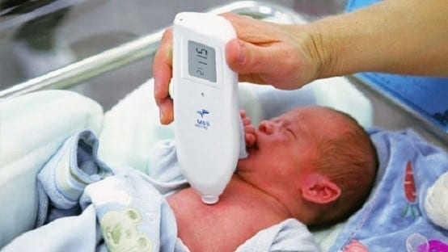
The New Guidelines
Assessment and Monitoring
How to check bilirubin
  Look at the baby (super unreliable)
    If appears jaundiced within 24h of birth, must check bili immediately
  Transcutaneous bili (TCB)
    Must wait 24+ hours from last use of phototherapy
    Margin of error ~3 pts
  Total serum bili (TSB – gold standard, use for treatment decisions)
    What about direct? Don't subtract, if rising consider obstructive processes
https://viaglobalhealth.com/product/handheld-rapid-test-jaundice-meter-mbj20/

Slide 15
The New Guidelines
Assessment and Monitoring
Check all babies at 24-48h
  TCB OK for basic screens
    Must check TSB if within 3 mg/dL of light level OR TCB ≥15 mg/dL
  Can consider rate of rise if multiple levels available
    ≥0.3 mg/dL per hour in first 24h or ≥0.2 mg/dL per hour after 24h is consider abnormal, should screen for hemolysis
  Use the difference between TCB/TSB and light level to determine follow-up
Note: If a breastfed baby comes back at 3-4 weeks of age with hyperbili OR at 2w of age when formula fed, check total + direct bili

Slide 16
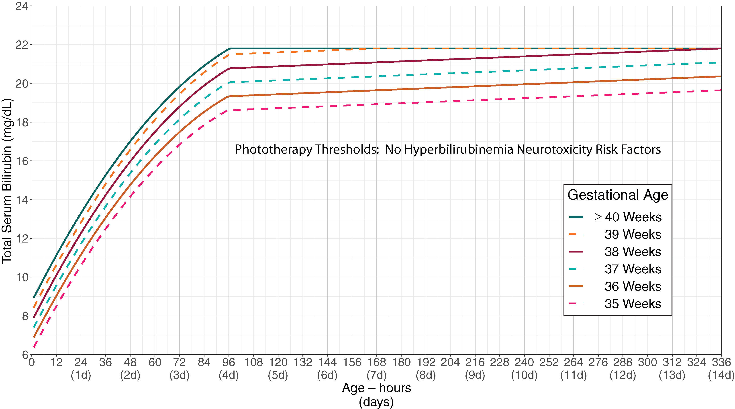

Slide 17
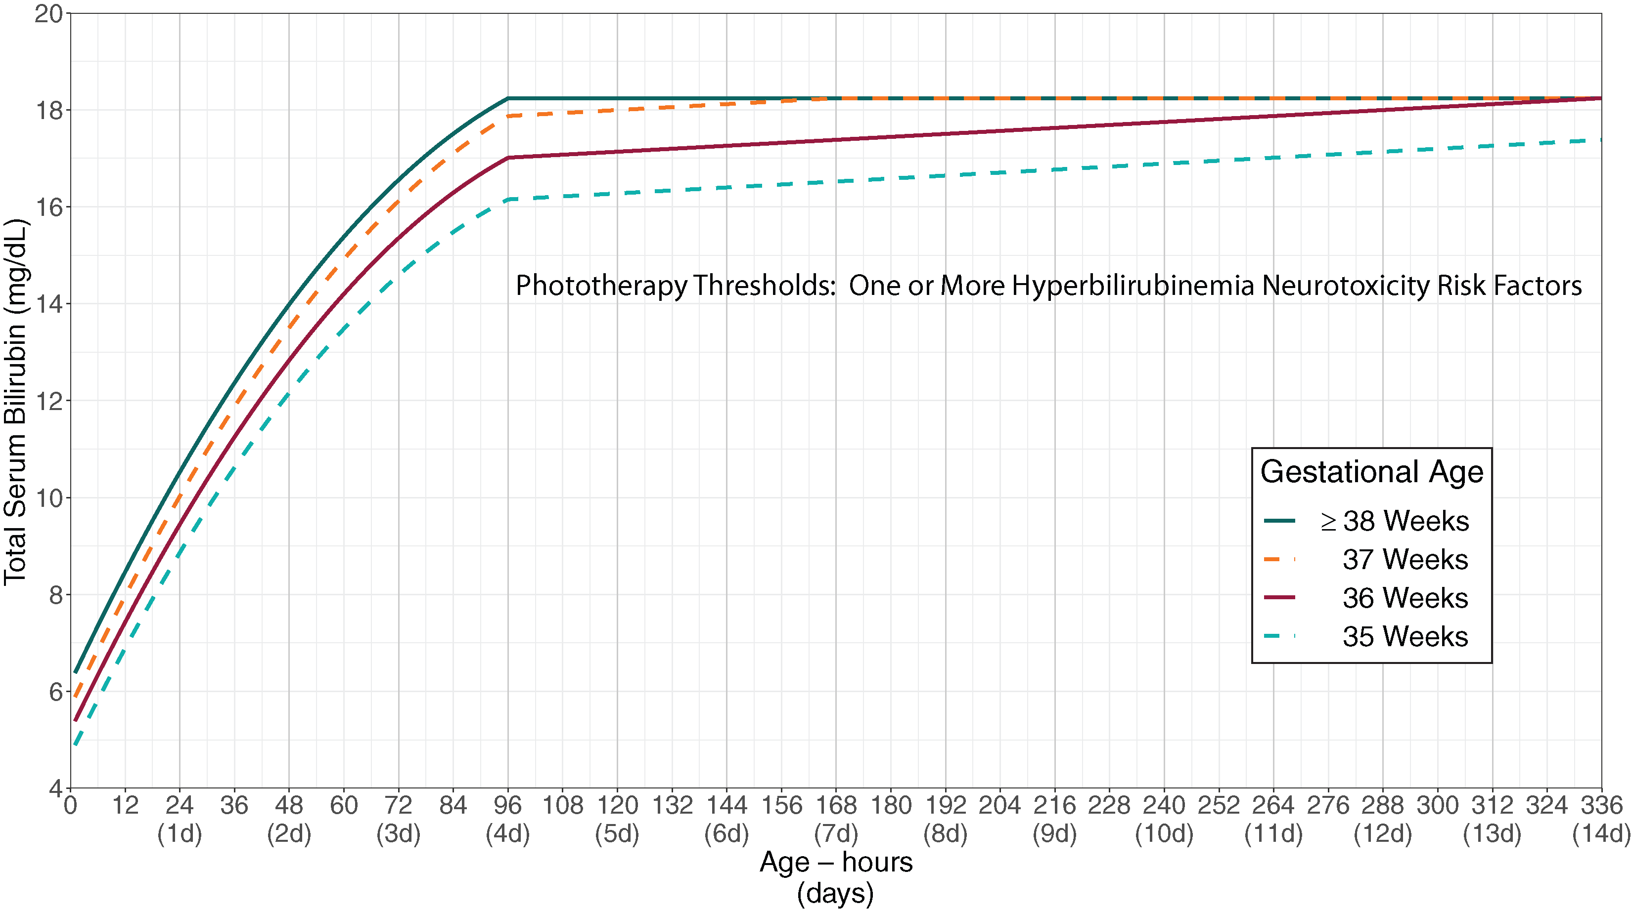

Slide 18
The New Guidelines
Starting Treatment
If TSB ≥ light level, check exchange transfusion chart and start phototherapy
  Select patients qualify for home photo
    Gestational age ≥38 weeks
    ≥48 hours old
    Clinically well with adequate feeding
    No known hyperbilirubinemia neurotoxicity risk factors (Table 2)
    No previous phototherapy
    TSB concentration no more than 1 mg/dL above the phototherapy treatment threshold
    An LED-based phototherapy device will be available in the home without delay
    TSB can be measured daily
If TSB ≤ light level, DON’T start phototherapy*
If TSB remains within 2 points of light level at day 7, consider pathologic causes of jaundice, can consider treatment even if not at light level

Slide 19
The New Guidelines
Monitoring success of phototherapy
In the hospital
  after starting lights, check next TSB within 12 hours
  Rechecks based on the presence of neurotoxicity risk factors, rate of rise, and TSB
  Other labs: check H/H (or CBC), DAT in babies of mothers with + antibody screen or if mom was O+/anything-
  Check for G6PD if TSB increases despite phototherapy
If doing home phototherapy, MUST check daily

Slide 20
The New Guidelines
Stopping Phototherapy
Can stop phototherapy when TSB had decreased by at least 2 mg/dL below the light level where you STARTED phototherapy
  Can prolong phototherapy if there are risk factors for rebound hyperbilirubinemia
    <38 weeks, <48 hours old at start of phototherapy, presence of hemolytic disease
Example:
  Start lights when TSB was 18 with light level was 17. Can stop when TSB is <15 IF no risk factors present

Slide 21
The New Guidelines
Follow-up after Lights
Infants at significant risk of rebound should have TSB rechecked 6-12 hours after lights discontinued as well as following day
  Risk factors: <48 hours old at start of lights, + DAT, known/suspected hemolytic disease
Infants without significant risk factors who received lights at birth hospital, check next day
Infants who received phototherapy during initial birth hospitalization and were READMITTED for lights should have bili checked next day after 2nd round of phototherapy discontinuation
Infants readmitted for lights who did NOT receive phototherapy during birth hospitalization should be rechecked 1-2 days later OR clinical follow-up
  (PCP can decide if they want to recheck based on assessment and presence fo risk factors)

Slide 22
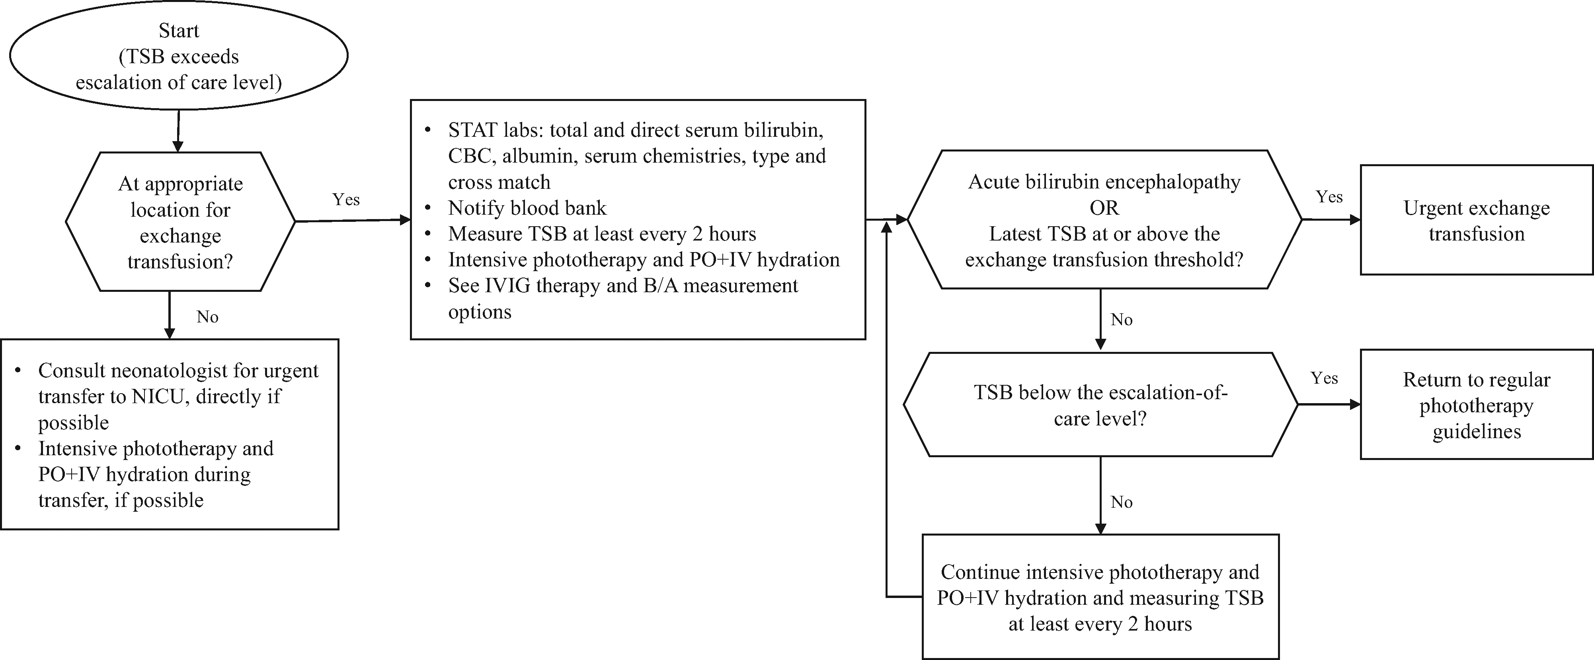
The New Guidelines
Escalation of Care
Escalation of care threshold = 2 mg/dL below exchange transfusion threshold

Slide 23
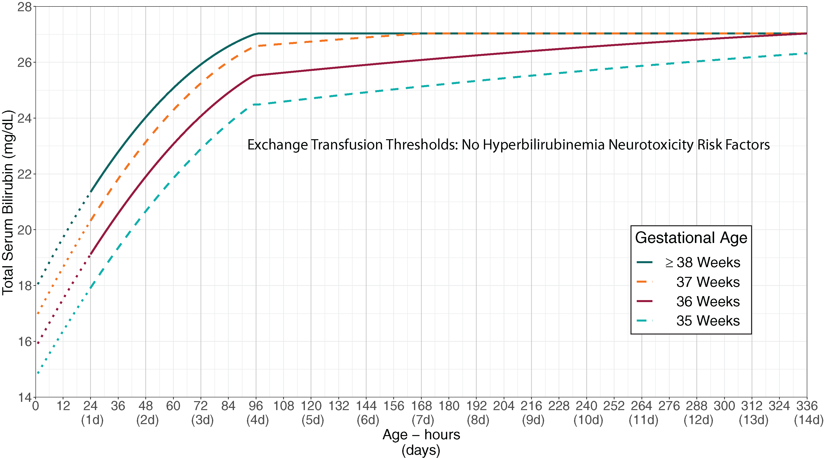

Slide 24
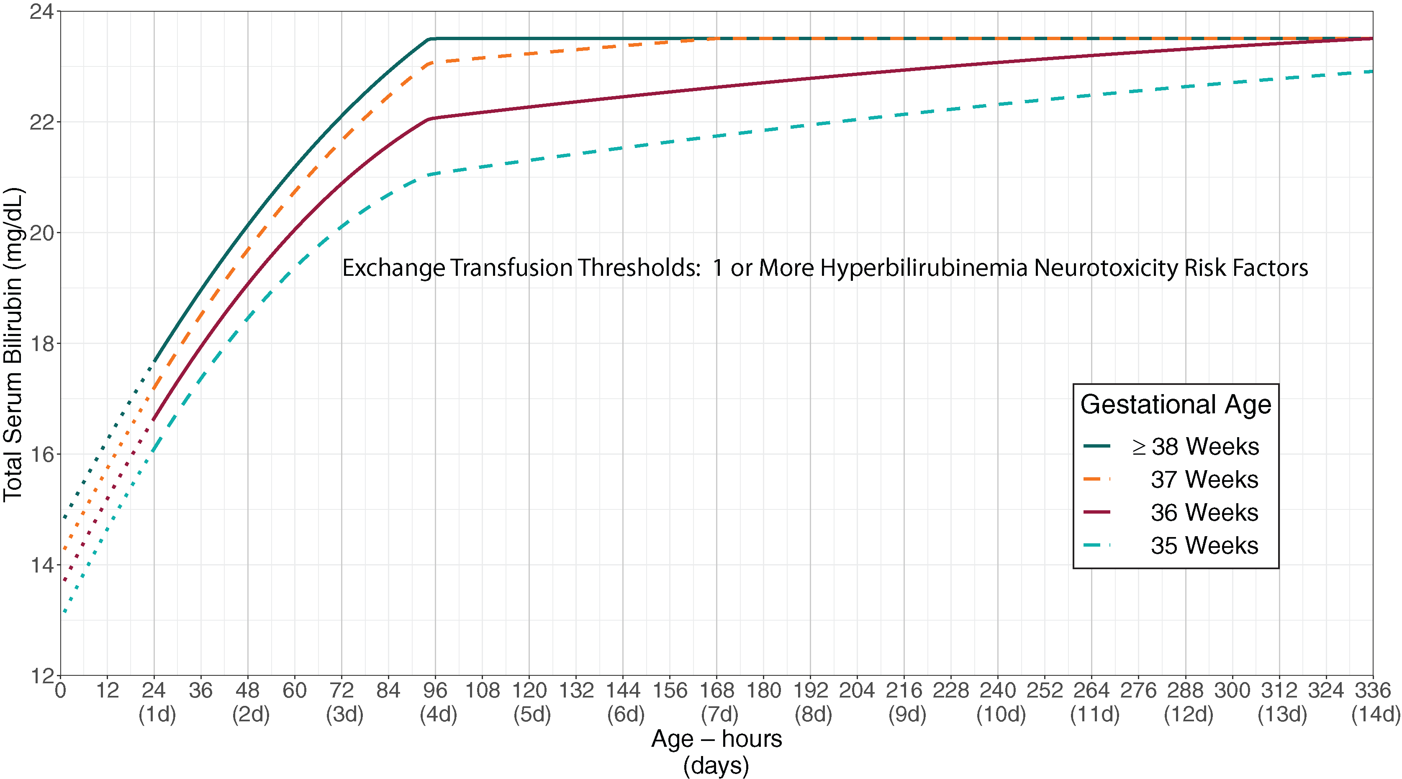

Slide 25
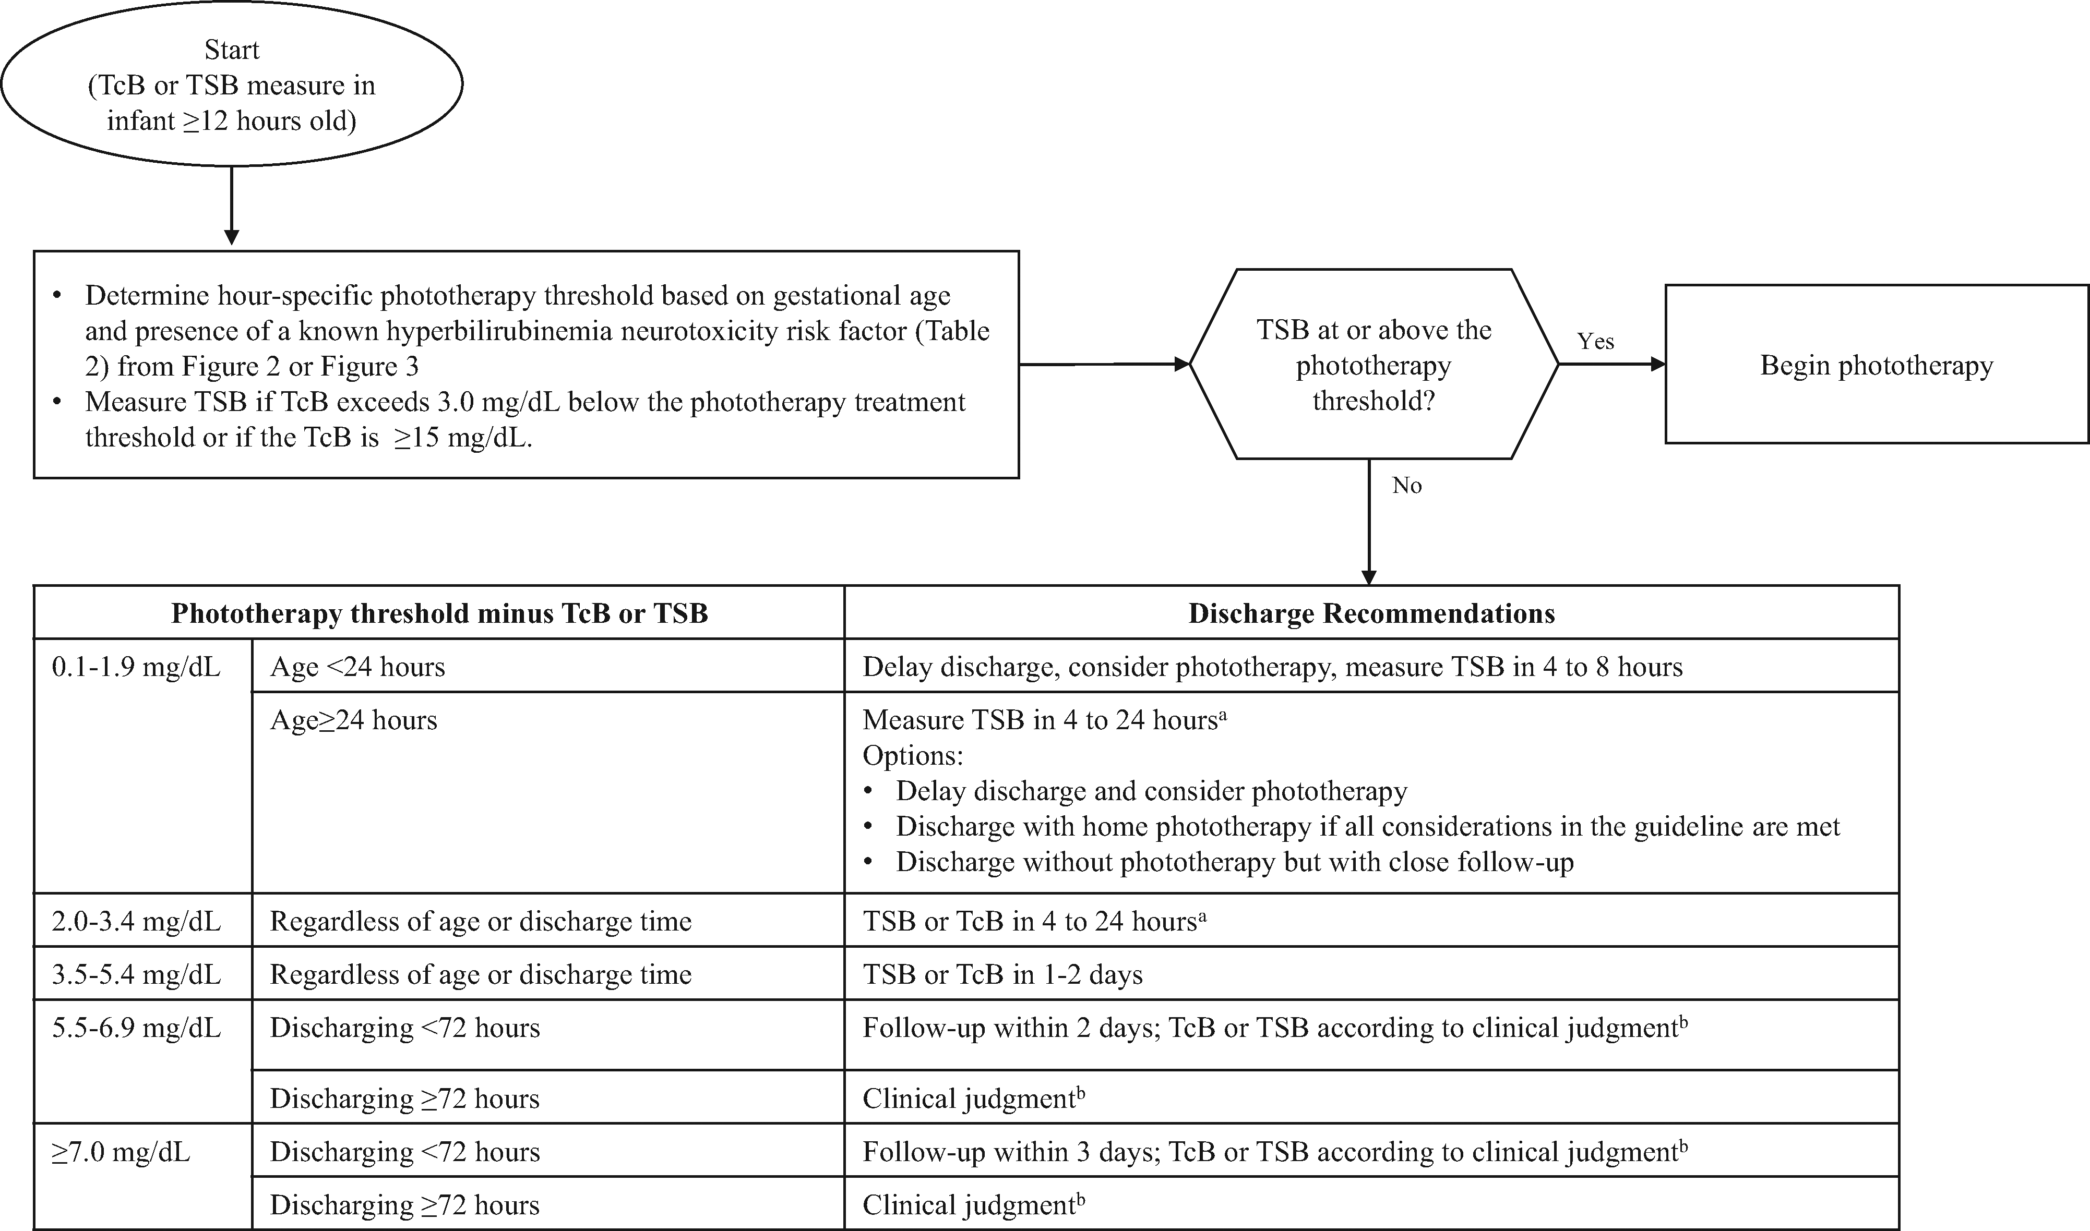
The New Guidelines
Follow-up after discharge

Slide 26
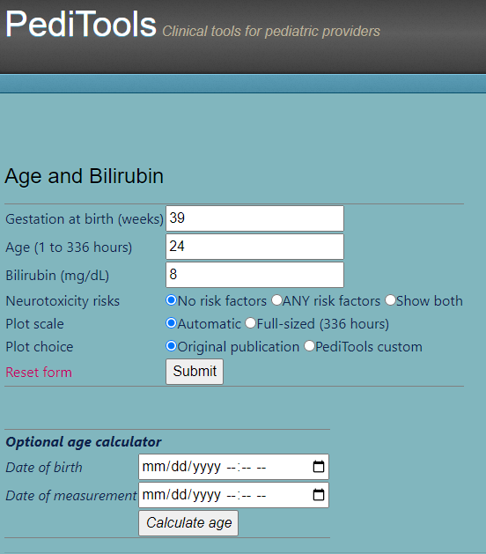
Case 1
Newborn delivered at 39 weeks to A+, antibody negative mother. Family requesting discharge at 24h. TCB was 7
  Go to peditools.org, type in the info, do whatever it says ;)
  Do you need to check a serum bili?

Slide 27
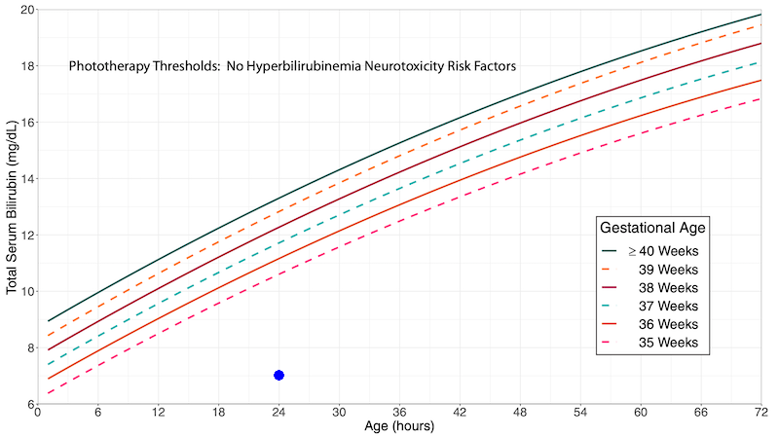
Case 1
Newborn delivered at 39 weeks to A+, antibody negative mother. Family requesting discharge at 24h. TCB was 7
  Go to peditools.org, type in the info, do whatever it says ;)
5.5 - 6.9 mg/dL | Discharging <72 hours | Follow-up within 2 days; TcB or TSB according to clinical judgment
 | Discharging ≥72 hours | Clinical judgment

Slide 28
Case 2
Newborn delivered at 39 weeks to A-, antibody + mother.

Slide 29
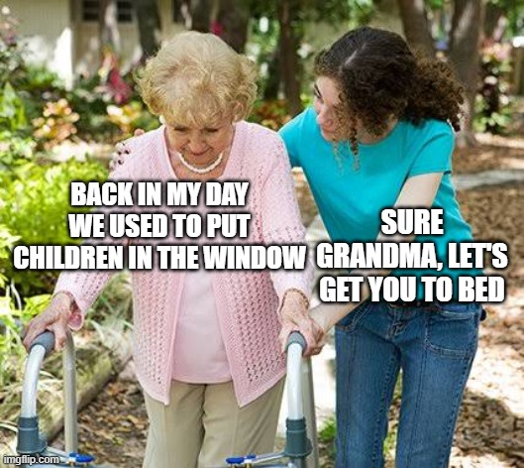
Case 3
Newborn born at 35 weeks (maternal indication) with 36h bili of 14. Family REALLY REALLY wants to go home

Slide 30
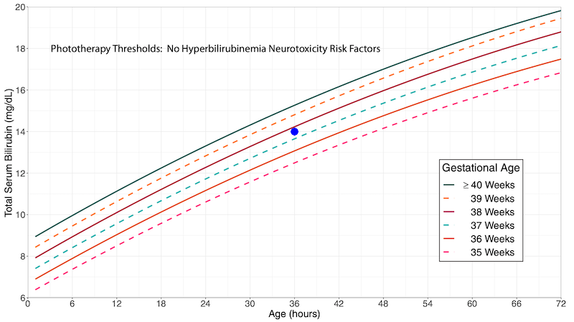
Case 3
Don't discharge
Start phototherapy
Recheck probably closer to 6h than 12h since young gestational age
Light level was 12.5, would probably keep lights going until TSB was <10.5

Slide 31
Case 4
Newborn born at 34 weeks. Bili 10 at 24 hours
  Wait... we didn't talk about preemies!
  Evidence at this age is lacking
  NICU uses a different set of cutoffs, much more aggressive about starting phototherapy given blood-brain barrier of premature infants is weak

Slide 32
Case 5
Newborn readmitted from PCP office for phototherapy
  No lights at birth hospital
  Bili in office was 19

Slide 33
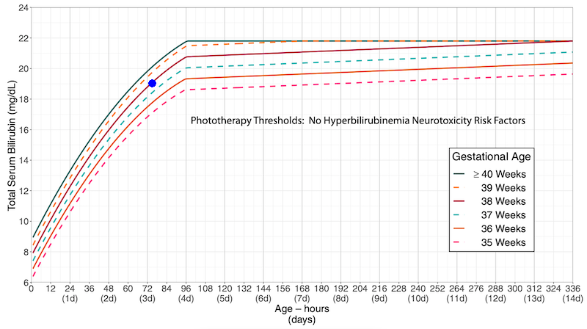
Case 5
Newborn readmitted from PCP office for phototherapy
  Admit, recheck bili (still 19), typically check CBC, blood/antibody, +/- retic
  Usually get lactation c/s, make sure mom is doing OK

Slide 34
Case 5, part 2
Recheck bili 6 hours later, and bili is now 20
  Two possibilities: wasn't in the lights enough OR there's something else going on
  Consider checking for G6PD if was sufficiently under the lights

Slide 35
Case 5, part 3
Bili comes down to 14, G6PD negative
  Stop lights, recheck in 1-2 days with PCP

Slide 36
Case 6
Newborn at 36 weeks, bili is 22.5 at 36 hours

Slide 37
Case 6
Newborn at 36 weeks, bili is 22.5 at 70 hours
  Light level 17.3, phototherapy threshold 23.9
  Call NICU for escalation of care

Slide 38
Objectives
By the end of this session, learns will be able to:
1) Define hyperbilirubinemia, jaundice, acute bilirubin encephalopathy, and kernicterus
2) Explain a few of the reasons neonates get hyperbilirubinemia
3) Describe the evaluation/management of neonatal hyperbilirubinemia based on the most current guidelines

Slide 39
Conclusion
Hyperbilirubinemia is nearly universal in infants
New guidelines just published with higher light levels

Slide 40

Thanks!

